Slide 1

YZY Language School
Ying HAO
Yaowu HUANG
Zhiwei LI
APR 19, 2021

Slide 2

Agenda - MVVM Architecture - Multiple Validations - UI Design - Drawing pie chart / bar chart - String Translation - Database Migration - Publish Install Packages

Slide 3
Technologies - MVVM Architecture - C# / WPF - Entity Framework (DB First) - RDBMS - 2D drawing (chart) - Globalization / Localization - Unit Test Challenges - MVVM Architecture - Multiple Validations (XAML, view model, model, database) - UI Design (Responsive, Tab, Animation Effect, User Control) - Drawing pie chart / bar chart - String Translation - Database Migration (Local to Azure) - Publish Install Packages

Slide 4
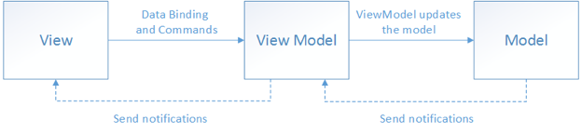
MVVM Architecture
Model (data layer) – View Model (logic layer) – View (user interface)
View is built on XAML only.
View model encapsulates the model.
View links with View Model via data binding and command binding.
The UI can be redesigned without touching the code (logic and data layers).
Unit tests can be built for the code (logic and data layers), without using UI.
Designers and developers can work independently.

Slide 5
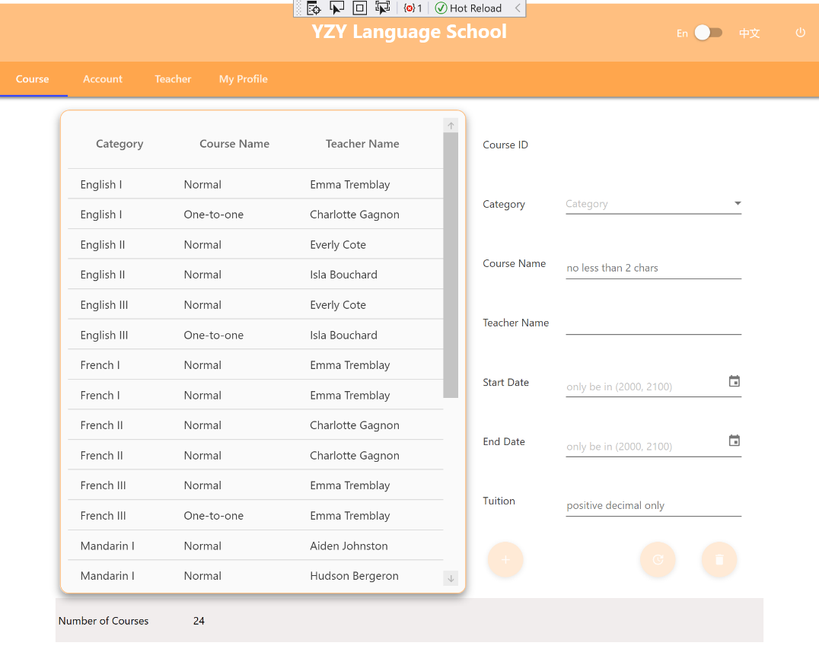
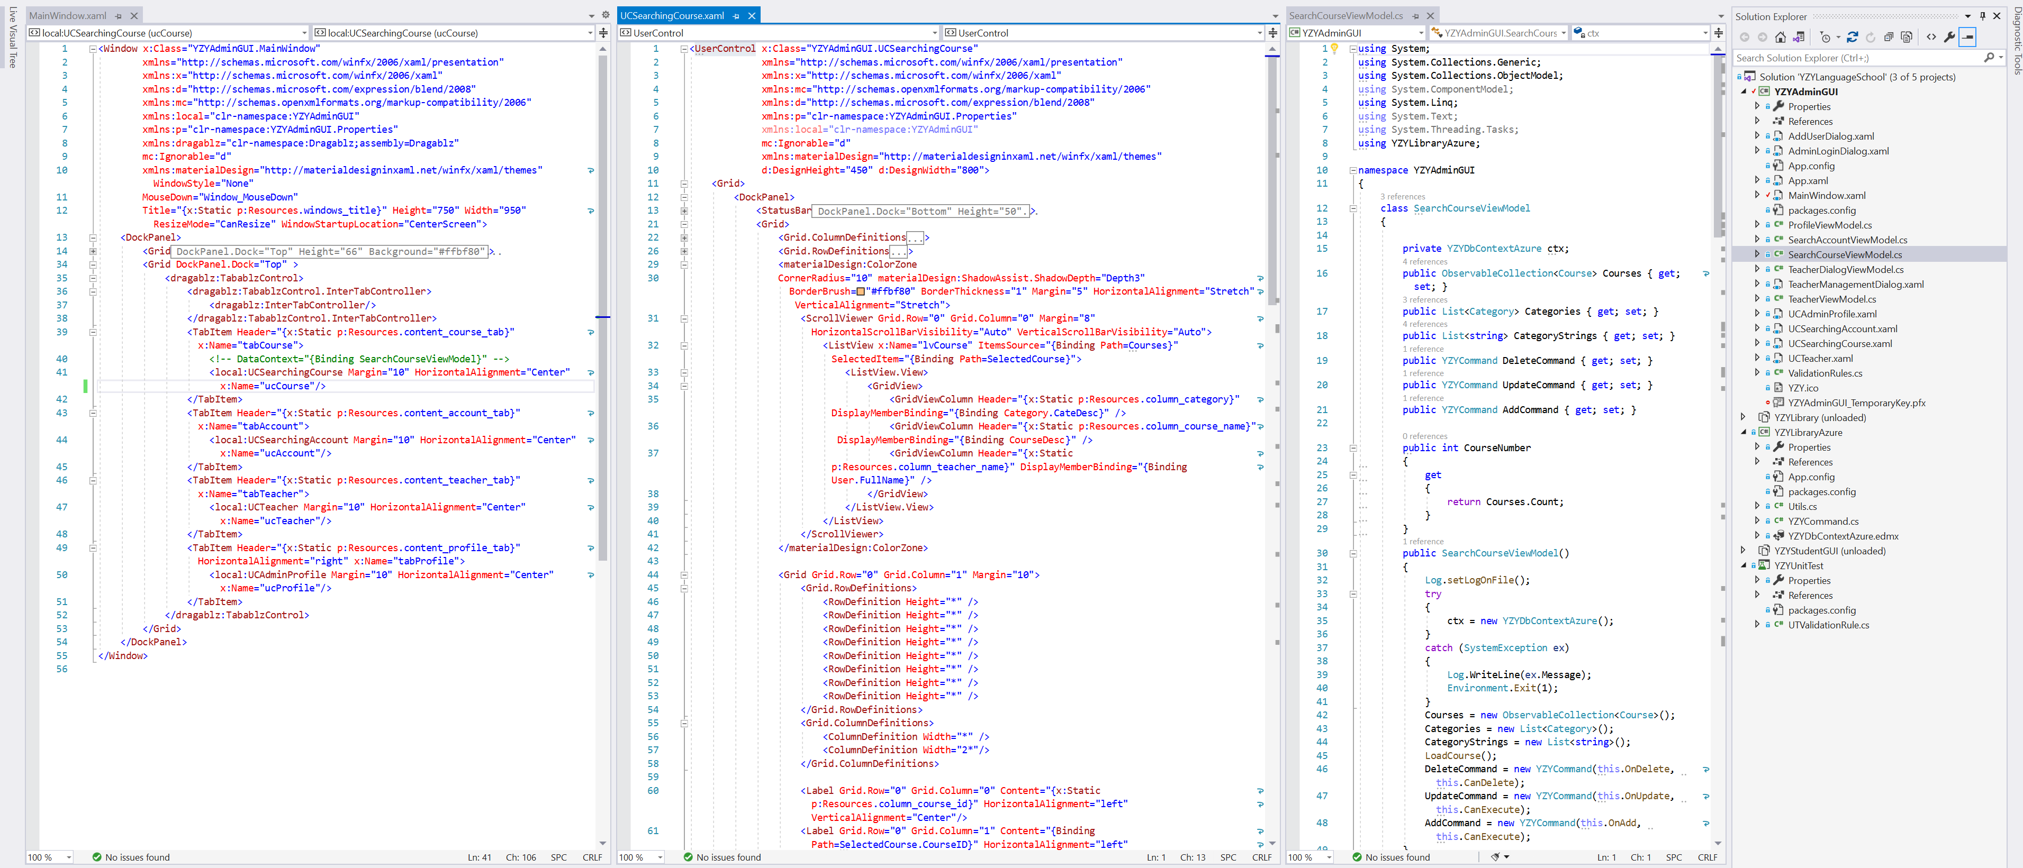
MVVM Architecture

Slide 6

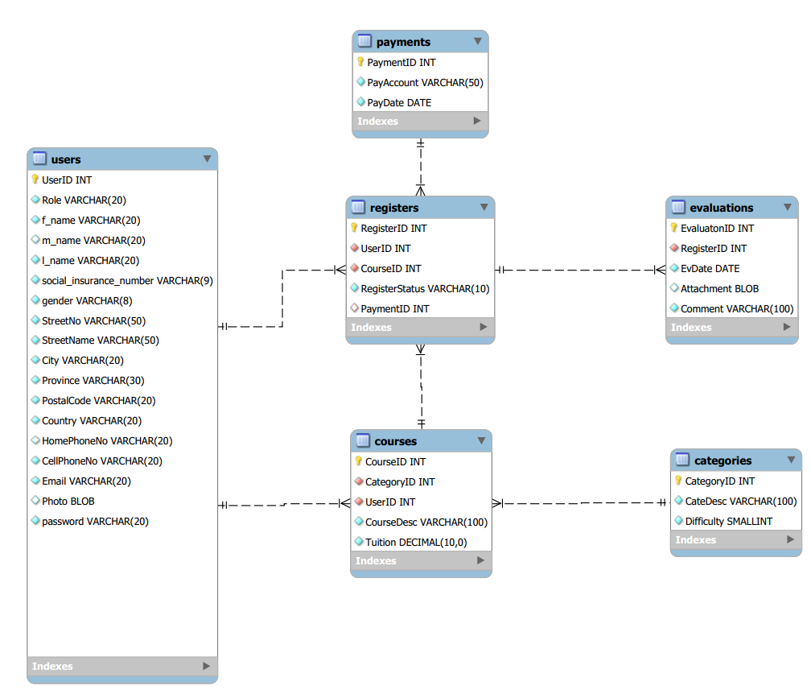
Database Migration

Slide 7
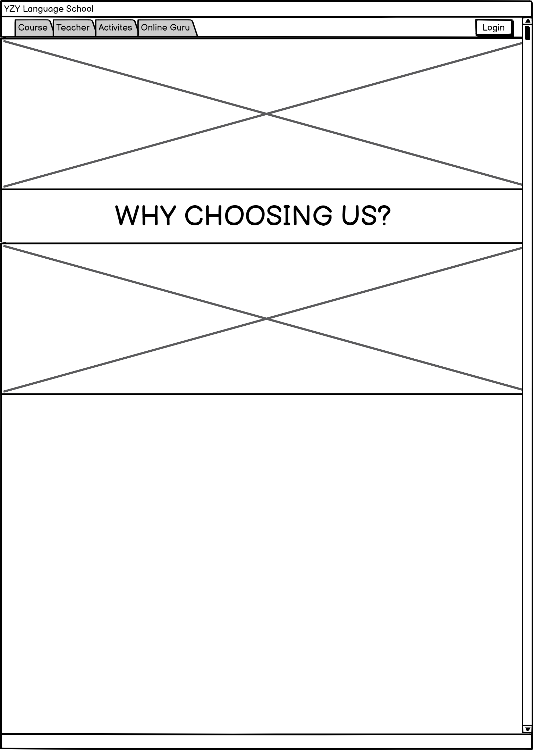
User Interface

